Slide 1
Monitoring in anaesthesia
By – Wosen. A (BSc, Msc)
Department of Anaesthesia, AAU

Slide 2
Why is monitoring important?
Improved patient safety
Improved quality of anaesthesia;
analgesia
awareness
There is a minimum standard of monitoring (UK)
Why is it important to learn about monitoring equipment?
Increasingly sophisticated
Awareness of limitations and sources of error essential
Knowledge enables sensible purchasing
Particularly in resource-limited environment;
Ability to solve simple equipment problems
Equipment maintenance

Slide 3
Classifying monitoring
Advantages
Disadvantages
Clinical
Non-invasive
Invasive
Free
No side effects
Not dependent on power
Limited information
Practical limitations
No side effects
Very informative
Known to improve safety
Labour saving
May be expensive
Usually require power
Additional information
Very expensive
Risk of injury
Risk of infection
Significant training required

Slide 4
Standards for basic anesthetic monitoring (AAGBI)
STANDARD I
Qualified anesthesia personnel shall be present in the room throughout the conduct of all GA, RA and monitored anesthesia care (MAC).
Objective
Because of the rapid changes in patient status during anesthesia, qualified anesthesia personnel shall be continuously present to monitor the patient and provide anesthesia care.
Remote observation of the patient in a known hazard area.
Temporary absence → Comparison of the emergency with the anesthetized patient’s condition and the selection of the person left responsible for the anesthetic during the temporary absence.

Slide 5
STANDARD II
During all anesthetics, the patient’s oxygenation, ventilation, circulation and temperature shall be continually evaluated.
“Continual” is defined as “repeated regularly and frequently in steady rapid succession” whereas
“Continuous” means “prolonged without any interruption at any time.”

Slide 6
1. Oxygenation
OBJECTIVE
To ensure adequate oxygen concentration in the inspired gas and the blood during all anesthetics.
METHODS
Inspired gas: During every administration of GA using an anesthesia machine, the concentration of oxygen in the patient breathing system shall be measured by an oxygen analyzer with a low oxygen concentration limit alarm in use.
Blood oxygenation: During all anesthetics, a quantitative method of assessing oxygenation such as pulseoxymetry shall be employed. When a pulseoxymetry is utilized, the variable pitch pulse tone and the low threshold alarm shall be audible.

Slide 7
2. Ventilation
OBJECTIVE
To ensure adequate ventilation of the patient during all anesthetics.
METHODS
Every patient receiving GA shall have the adequacy of ventilation continually evaluated. Qualitative clinical signs such as chest excursion, observation of the reservoir breathing bag and auscultation of breath sounds are useful.
During RA & MAC continual observation of qualitative clinical signs and/or monitoring for the presence of exhaled carbon dioxide shall be performed.

Slide 8
Continual end-tidal carbon dioxide analysis, in use from the time of endotracheal tube/laryngeal mask placement, until extubation/removal or initiating transfer to a postoperative care location, shall be performed using a quantitative method such as Capnography, Capnometry or mass spectroscopy.
When ventilation is controlled by a mechanical ventilator, there shall be a continuous use a device that is capable of giving an alarm when its alarm threshold is exceeded.

Slide 9
3. Circulation
OBJECTIVE
To ensure the adequacy of the patient’s circulatory function during all anesthetics.
METHODS
Every patient receiving anesthesia shall have the ECG continuously displayed .
Every patient receiving anesthesia shall have arterial BP & HR determined and evaluated at least every five minutes.
In addition to the above, circulatory function continually evaluated by at least one of : palpation of a pulse, auscultation of heart sounds, or pulse plethysmography or oximetry.

Slide 10
4. Body Temperature
OBJECTIVE
To aid in the maintenance of appropriate body temperature during all anesthetics.
METHODS
Every patient receiving anesthesia shall have temperature monitored when clinically significant changes in body temperature are intended, anticipated or suspected.

Slide 11
STANDARD II - summary
Oxygenation
Oxygen analyzer for inspired gases
Observation of the patient
Pulseoxymetry
Ventilation
Auscultation
Observation of the patient
Observation of reservoir
End-tidal carbon dioxide analysis
Circulation
Continuous ECG display
Heart rate and BP recorded every 5 min
Auscultation of heart sound, palpation of pulse, pulse plethysmography, pulseoxymetry, intra-arterial pressure tracing
Temperature
Core and/or skin temperature

Slide 12
Contents
Clinical monitoring
Pulseoxymetry
Capnography
Non invasive Blood pressure
ECG
Peripheral nerve stimulators
Volatile / gas analyser & anaesthesia depth
Temperature monitoring
Documentation

Slide 13
How to think about monitoring
What information does it give?
Physiology
Continuous / periodic
Interpretation
Clinical relevance
Components
How does it work?
What exactly is being measured and
How?
What are the limitations / benefits?
Sources of error
Cost
Risks

Slide 14
Clinical monitoring / observation
A
B
C
D
E
= Airway
Mask / ET tube misting/vaporing
Feel of reservoir bag
Chest movement
= Breathing
Colour
Bilateral equal chest movement
Bilateral equal air entry
Pulse
= Circulation
Colour
Peripheral vs central temperature
Pulse (present, character, rate, rhythm)
Urine output
= Depth of anaesthesia
Eyes
Movement
Response to stimuli
Pulse, BP
Respiratory rate
Ability to ventilate
= ‘Environment’
Central temperature

Slide 15
Chapter Five
Respiratory System Monitoring

Slide 16
1. Pulseoxymetry

Slide 17
Introduction
Pulse oximetry, sometimes called the fifth vital sign, is a continuous noninvasive method of measuring hemoglobin saturation (SpO₂) by using a light signal transmitted through tissue.
Arterial blood haemoglobin saturation at the level of arterioles.
A low SpO₂ can provide warning of hypoxemia before other signs such as cyanosis or a change in heart rate are observed.

Slide 18
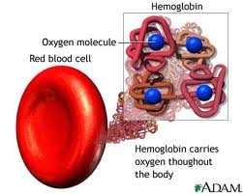
What is oxygen saturation ?
Red blood cells contain hemoglobin.
One molecule of hemoglobin can carry up to four molecules of oxygen after which it is described as “saturated” with oxygen.
If all the binding sites on the hemoglobin molecule are carrying oxygen, the hemoglobin is said to have a saturation of 100%.
Most of the hemoglobin in blood combines with oxygen as it passes through the lungs.
A healthy individual with normal lungs breathing air will have an arterial oxygen saturation of 95% – 100%.
Venous blood that is collected from the tissues contains less oxygen and normally has a saturation of around 75%.

Slide 19
Cont’d …
Arterial blood looks bright red whilst venous blood looks dark red.
The difference in color is due to the difference in hemoglobin saturation.
When patients are well saturated their tongues and lips appear pink in color; when they are very de-saturated they appear blue. This is called cyanosis.
However, it is difficult to detect cyanosis clinically, particularly in a dark skinned patient, and you may not notice this sign until the oxygen saturation is less than 90%.
In a dark operating theatre detecting cyanosis is even harder!
Cyanosis is only visible when the hemoglobin concentration is greater than 5 g/dl.

Slide 20
Cont’d …
A severely anemic patient may not appear cyanosed even when extremely hypoxic as there is very little hemoglobin circulating through the tissues.
During anaesthesia the oxygen saturation should always be 95 - 100%.
If the oxygen saturation is 94% or lower, the patient is hypoxic and needs to be treated quickly.
A saturation of less than 90% is a clinical emergency.

Slide 21
Operating Principles
The pulseoxymetry estimates SpO₂ from the differential absorption of red and infrared light in tissue.
The two wavelengths allow differentiation of reduced hemoglobin and oxyhemoglobin.
Reduced hemoglobin absorbs more light in the red band than oxyhemoglobin while the oxyhemoglobin absorbs more light in the infrared band.
The pulseoxymetry computes the ratio between these two signals and relates this ratio to the arterial oxygen saturation, using an empirical algorithm.
Pulseoxymetry discriminates between arterial blood and other components by determining the change in transmitted light caused by the flow of arterial blood.

Slide 22
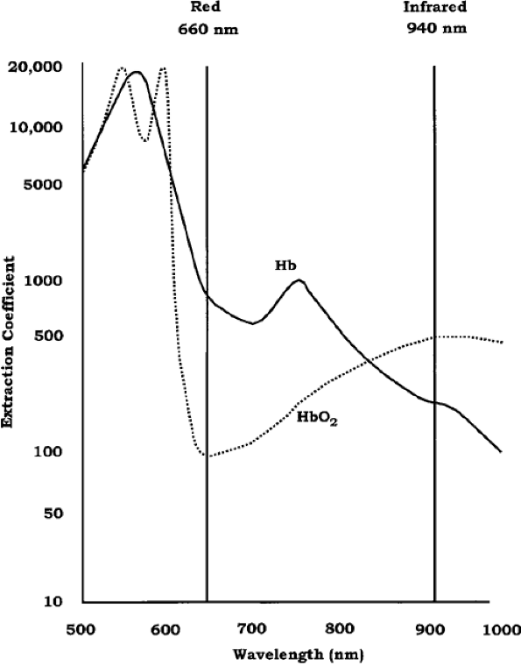
Absorbance of light as a function of wavelength.
At the red wavelengths (650 to 750 nm), reduced hemoglobin absorbs more light than does oxyhemoglobin.
In the infrared region (900 to 1000 nm), the reverse is true.

Slide 23
Components
Probe with 2 LED’s and photodetector
Case contains microprocessor and display screen
Photodetector
Microprocessor
660
nm
940
nm
on
off
Allows for subtraction of background light
30 times / second
off
on
off
off

Slide 24
Cont’d …
The oximeter pulses the red and infrared LEDs ON and OFF several hundred times per second.
Oximeters have a phase with both LEDs OFF to allow detection of and compensation for extraneous light. Light readings during the OFF period are subtracted from the next sequence.
Fractional oxygen saturation (% HbO₂) is the ratio of oxyhemoglobin to the sum of all hemoglobin species present, whether available for reversible binding to oxygen or not.
Functional oxygen saturation (SaO₂) is defined as the ratio of oxyhemoglobin to all functional hemoglobins.

Slide 25
Types
Transmission Pulse Oximetry
Most common type of pulse oximeter.
With this technology, a light beam is transmitted through a vascular bed and is detected on the opposite side of that bed.
Reflectance Pulse Oximetry
Reflectance oximetry relies on light that is reflected (backscattered) to determine oxygen saturation.
The probe has both an LED and a photodiode.
The signals are weaker than those found in transmission oximetry, so the photodiode area needs to be as large as possible.

Slide 26
Physiology
Efficient oxygen transport relies on the ability of hemoglobin to reversibly load and unload oxygen.
There are five important things that must happen in order to deliver enough oxygen to the tissues:
Oxygen must be breathed in (or inspired) from the air or anaesthesia circuit into the lungs.
Oxygen must pass from the air spaces in the lung (called the alveoli) to the blood. This is called alveolar gas exchange.
The blood must contain enough hemoglobin to carry sufficient oxygen to the tissues.
The heart must be able to pump enough blood to the tissues to meet the patient’s oxygen requirements
The volume of blood in the circulation must be adequate to ensure oxygenated blood is distributed to all the tissues.

Slide 27
Cont’d …
The heart normally pumps approximately 5000 ml of blood per minute to the tissues in an average sized adult.
This delivers about 1000 ml of oxygen to the tissues per minute.
The cells in the tissues extract oxygen from the blood for metabolism, normally around 250ml of oxygen per minute.
This means that if there is no oxygen being exchanged in the lung, there is only enough oxygen stored in the blood for around 3 minutes.
Anemic patients have lower levels of hemoglobin and are therefore unable to carry as much oxygen in the blood.

Slide 28
Cont’d …
At a hemoglobin concentration of less than 6g/dl, delivery of oxygen to the tissues may become too low to meet the metabolic demands.
Patients who suffer major blood loss during surgery and become acutely anemic should be given 100% oxygen to breathe.
This will increase the amount of dissolved oxygen in the blood and will improve tissue oxygen delivery by a small amount.
The relationship between oxygen tension and oxygen binding is seen in the oxyhemoglobin dissociation curve, which plots the hemoglobin oxygen saturation against the oxygen tension.

Slide 29
Cont’d …
The sigmoid shape of the curve is essential for physiologic transport.
As oxygen is taken up in the lungs, the blood is nearly fully saturated over a large range of tensions.
During passage through the systemic capillaries, a large amount of oxygen is released with a relatively small drop in tension.
This allows oxygen to be released at sufficiently high concentrations to provide an adequate gradient for diffusion into the cells.
The shape of the oxyhemoglobin dissociation curve limits the degree of desaturation that can be tolerated.

Slide 30
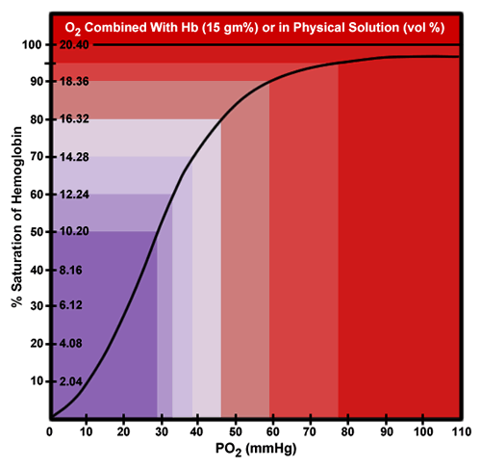
Cont’d …
Between 90% and 100% saturation, the partial pressure of oxygen in arterial blood (PaO₂) will be 60 mmHg or above.
Below 90% saturation, the curve becomes steeper, and small drops in saturation correspond to large drops in oxygen partial pressure.
If a problem develops, there may not be much warning before the oxygen level becomes dangerously low.
Normal saturation will decrease as altitude above sea level increases. FX

Slide 31
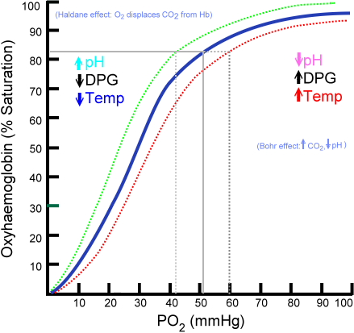

Slide 32
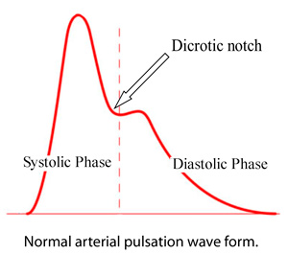
Plethysmography
The plethysmograph signal amplitude is directly proportional to the vascular distensibility over a wide range of cardiac output.
A correlation between pulse waveform amplitude variation during PPV and hypovolemia has been reported.
If brief interruption of ventilation causes the waveform to return to normal or more constant function, a trial of fluid therapy may be warranted.
During anesthesia, the un-gained pulseoximeter signal may be used to determine the extent of attenuation of the sympathetic response to stimuli.
Another important feature of the waveform is the dicrotic notch.
The notch tends to descend toward the baseline during increasing vasodilation and gets higher with vasoconstriction.

Slide 33
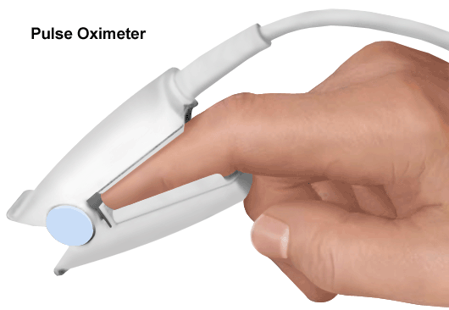
Sites
1. Finger
The probe is most commonly attached over the fingertip.
The failure rate is less, and accuracy is better when the probe is placed on the finger than on the earlobe.
The finger is relatively sensitive to sympathetic system vasoconstriction.
Vigorously rubbing the fingertip may temporarily improve circulation to the area.
A disadvantage of placing a probe on an extremity is that detection of desaturation and re-saturation is slower than when probes are placed more centrally.
Response time may be quicker when the probe is placed on the thumb.

Slide 34
Cont’d …
Motion artifacts are less frequent when the probe is placed on one of the larger fingers.
The probe may be placed over a finger that has a burn.
The probe should not be on the index finger during recovery. As a patient awakens, the patient often will want to rub his or her eye, usually with the index finger. If the oximeter probe is on that finger, the cornea can be scratched.
In general, the arm opposite from that on which the blood pressure cuff is applied or in which an arterial catheter has been inserted should be used.
Occasionally, poor function may occur with probe attachment to the same extremity as the intravenous infusion, due to local hypothermia and vasoconstriction.

Slide 35
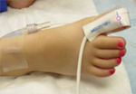
2. Toe
An alternate site when the finger is not available or the signal from the finger is unsatisfactory.
Detection of desaturation or re-saturation will not be as rapid as with more centrally placed probes.
The delay in detection of hypoxemia may be up to 1 to 2 minutes.
The toe may provide a more reliable signal in patients who have had an epidural block.
An increase in pulse amplitude from the toe may be a sign of a successful block.

Slide 36
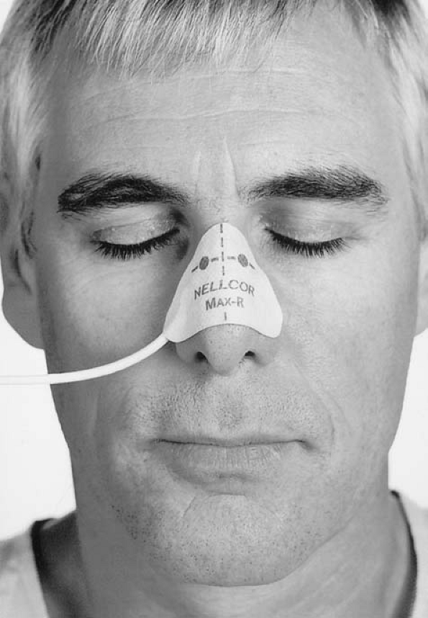
3. Nose
The nose is usually a convenient location.
Nasal probes respond more rapidly to changes in saturation than probes placed on extremities.
The bridge, the wings of the nostrils, and the nasal septum have been used.
It has been recommended under conditions such as hypothermia, hypotension, and infusion of vasoconstrictor drugs.
If the patient is placed in the Trendelenberg position, venous congestion may occur around the nose, causing the pulse oximeter to display artificially low saturations.

Slide 37
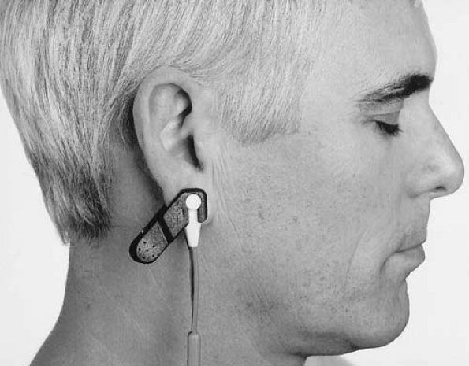
4. Ear
The earlobe should be massaged for 30 to 45 seconds with alcohol or vasodilator.
An ear probe can be particularly useful when there is finger motion.
Response time is faster with an ear probe than with a finger probe.
A steep head down position may result in erroneous readings.

Slide 38
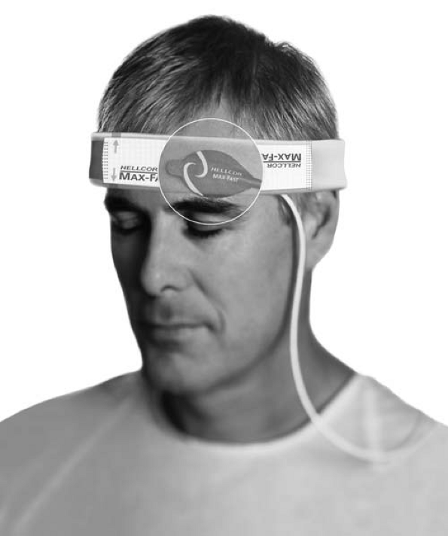
5. Forehead
A flat reflectance pulse oximeter sensor can be used on the forehead.
It should be placed just above the eyebrow so that it is centered slightly lateral of the iris.
This site is usually easily accessible.
The forehead is less affected by vasoconstriction from cold or poor perfusion than the ear or finger.
Changes in saturation can be detected more rapidly at the forehead than at the finger.
However, pooling of venous blood due to compromised return to the heart may cause low saturation readings and It should not be used if the patient is in the trendelenburg position.

Slide 39
6. Other sites
Tongue, cheek, esophagus, palm, foot, penis, ankle, lower calf, or even the arm in infants.
Pulse oximetry may be used to monitor fetal oxygenation during labor by attaching a reflectance pulse oximetry probe to the presenting part.

Slide 40
Applications
Anesthesizing areas
Post-anesthesia Care Unit
Transport
Other Intra-hospital Areas
Out-of-hospital Use
Controlling Oxygen Administration/ Avoiding Hyperoxemia
Monitoring Peripheral Circulation – SA, Ortho,
Determining Systolic Blood Pressure
Locating Arteries - apply & block artery

Slide 41
If no signal is obtained on the oximeter after the probe has been placed on a finger, check the following:
Is the probe working and correctly positioned? Try another location.
Does the patient have poor perfusion?
Check for low cardiac output especially due to hypovolemia, cardiac problems or septic shock. If hypotension is present, resuscitation of the patient is required immediately. The signal will improve when the clinical condition of the patient improves.
Check the temperature of the patient. If the patient or the limb is cold, gentle rubbing of the digit or ear lobe may restore a signal.

Slide 42
problems that can cause a drop in oxygen saturation include (Discuss and group)
Fat embolism,
Amniotic fluid embolism,
Pulmonary edema,
Breathing system disconnections and leaks,
Aspiration,
Tracheal tube obstruction,
Hypoxic gas mixture,
Oxygen delivery failure,
Hypoventilation,
Anaphylaxis,
Bronchospasm,
Pneumothorax,
Malignant hyperthermia, and
Pulmonary embolism

Slide 43
Limitations
Accuracy - +/- 2% (in 70-100% range)
- Trend is important
Severe hypoperfusion limits reading
Only measures O₂ saturation (not about O₂ tissue delivery or CO₂ removal)
Delay in response time to desaturation (NOT suitable for primary assessment of intubation)
Movement may affect reading

Slide 44
Limitations – source of error
Increased venous pulsation may cause inaccuracy
HbF No significant change
MetHb False low reading (tends to 85%)
CO.Hb False high reading
SulphHb No problem
Dark skin No problem
Methylene blue False low reading
Nail varnish May cause false low reading
Costs Starting from $200
FRAGILE
Risks May cause pressure sores with
prolonged use

Slide 45
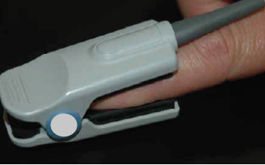
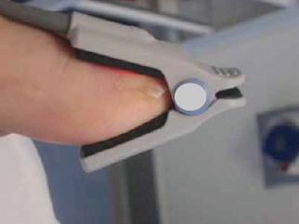
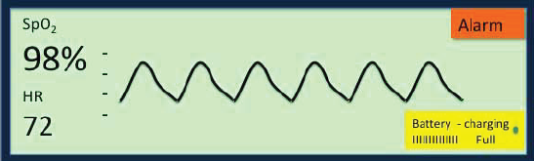
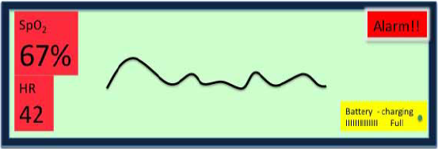
Say something about these pictures

Slide 46
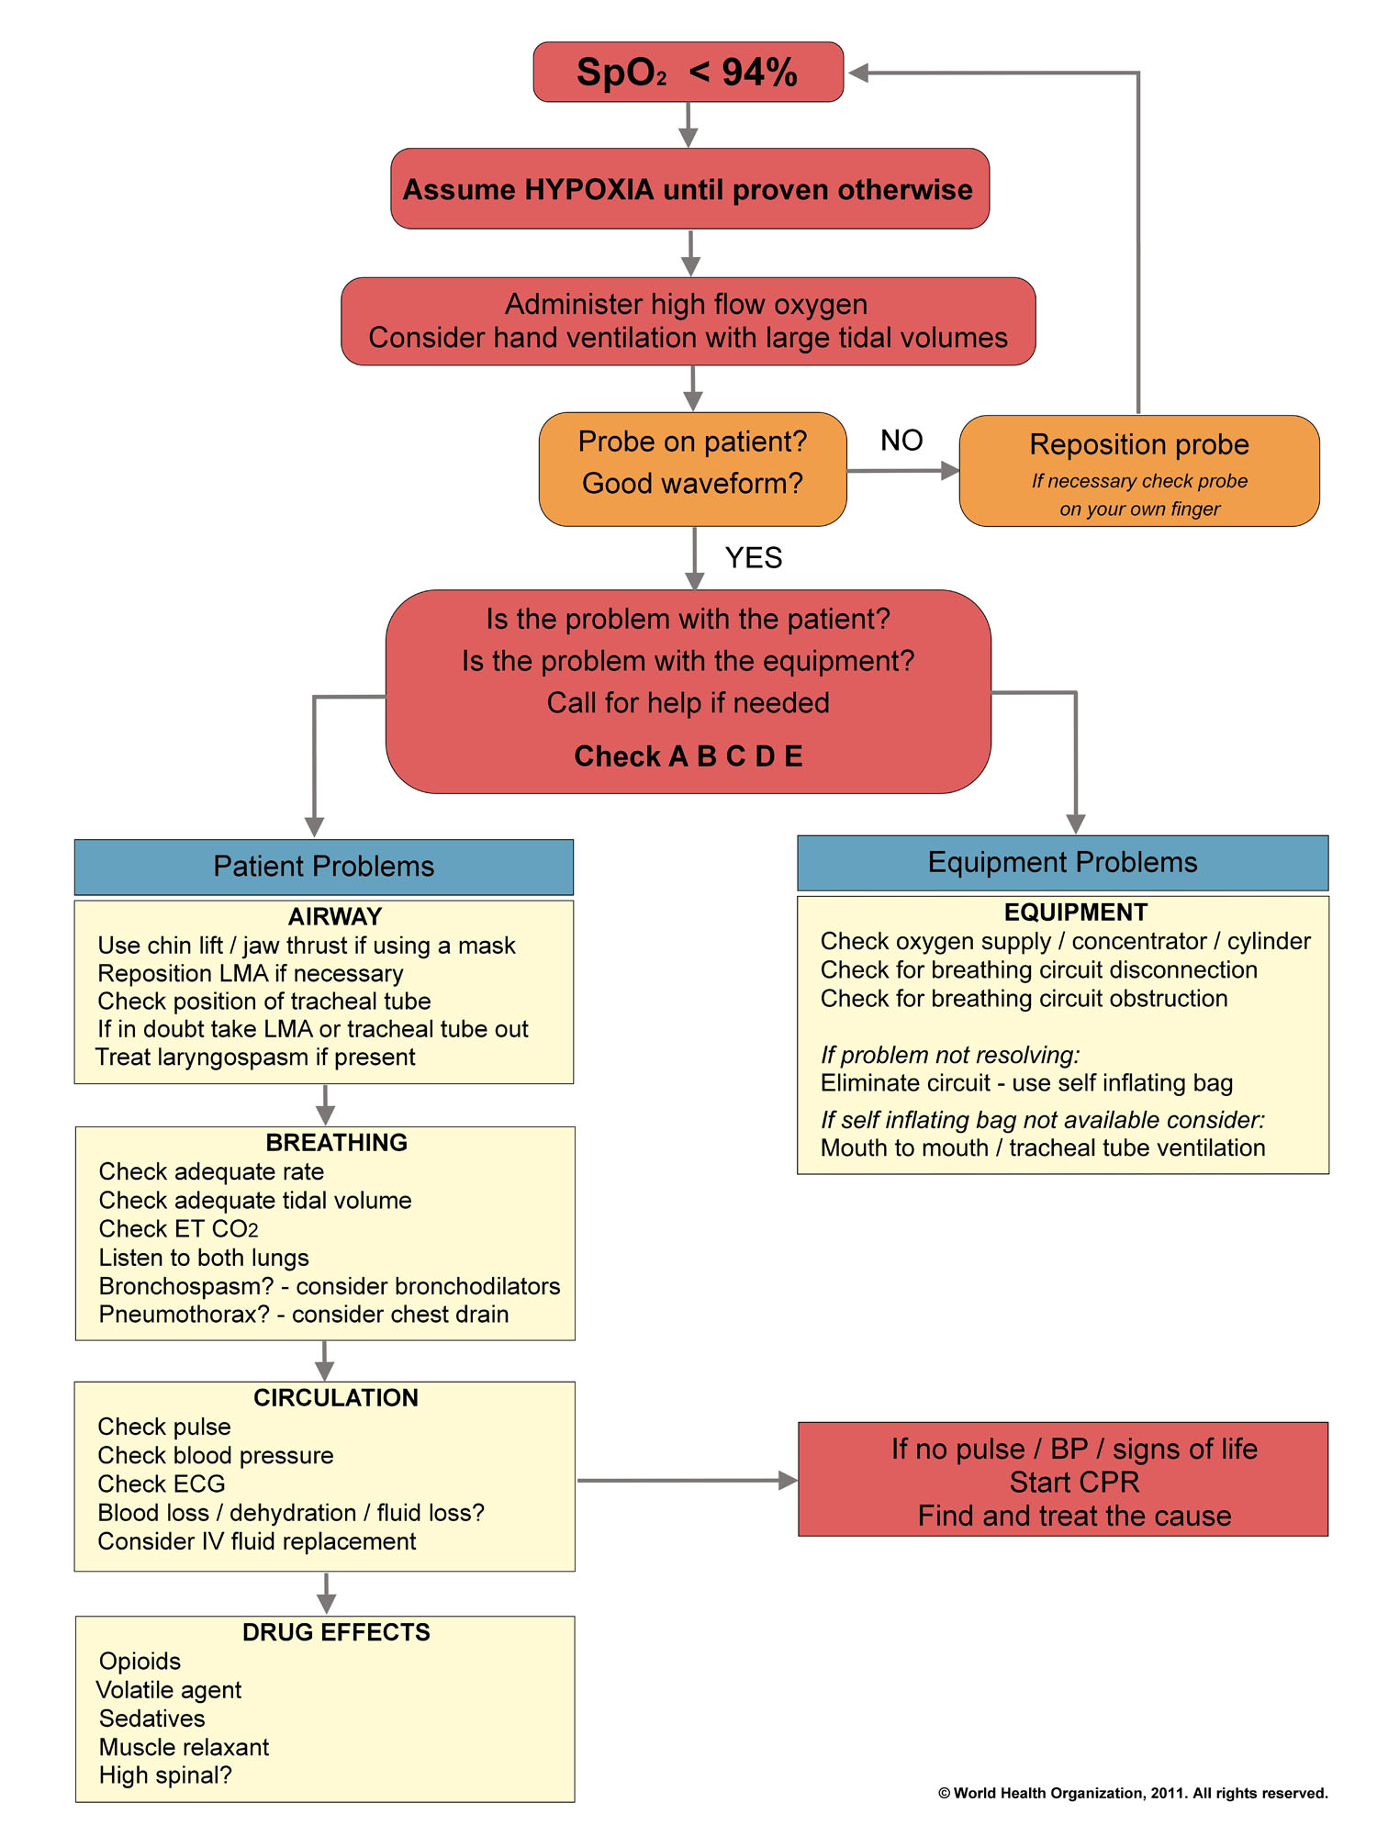
Desaturation Rx algorithm

Slide 47
Learning points summary
It is difficult to detect cyanosis clinically until the saturation is <90%. A patient who is severely anemic may not appear cyanosed, even if the oxygen saturation is very low.
In order to get a satisfactory reading the probe must be emitting a red light and must be correctly positioned to detect pulsatile blood flow.
If you are uncertain that the probe is working properly, check it by testing it on your own finger.
During anaesthesia the SpO2 should be 95% or above. If SpO2 is 94% or below, the patient must be assessed quickly to identify and treat the cause.
SpO2 OF ! 90% IS A CLINICAL EMERGENCY AND SHOULD BE TREATED URGENTLY.
Hypovolemia is the most common cause of a weak pulse oximeter signal during anaesthesia. Hypothermia should also be considered.
ALWAYS make sure the ALARMS are ON !!!

Slide 48
Anesthetic Monitoring
Clinical monitoring
Pulseoxymetry
Capnography
Non invasive Blood pressure
ECG
Peripheral nerve stimulators
Volatile / gas analyser & anaesthesia depth
Temperature monitoring
Documentation
√
√

Slide 49
2. Capnography

Slide 50
Learning Objective
Define and describe ETCO₂
Explain Methods of measuring ETCO₂
Describe various clinical applications of ETCO₂
Describe relationship between exhaled and arterial ETCO₂
Identify common waveforms

Slide 51
Introduction
The measurement of end-tidal CO2 (ETCO2) currently is the optimal method of continuously monitoring the adequacy of ventilation and circulation in adult through infants.
Capnography measures expired carbon dioxide using infrared spectroscopy (Real time end-tidal CO₂ recording).
Normally end-tidal CO2 reflects the partial pressure of CO2 in the alveoli.
ETCO2 can be of value in the assessment of ventilation, metabolism, and of a patient’s circulation status.

Slide 52
Cont’d …
Vast amount of information can be interpreted from the CO₂ trace.
Normal PaCO2 is 35-45 mmHg.
In adults with normal cardiorespiratory function (normal ventilation and perfusion) the ETCO2 is 2-5mmHg lower than the PaCO2, this is generally due to alveolar mixing.
In infants and small children the gradient is lower and closely reflects PaCO2 (< 3mmHg). This is due to better V/Q matching and hence a lower alveolar dead space
Generally:
ET_{CO2} < PA_{CO2} < Pa_{CO2}

Slide 53
Glossary
Capnography – Measurement with graphic as well as numeric display of carbon dioxide
Capnogram – A graphical waveform display of carbon dioxide concentration over time
Capnometry – Measurement with numeric display of carbon dioxide
CO2 – Carbon Dioxide, a byproduct of cellular metabolism that is exhaled during the respiratory cycle
End Tidal CO2 – Peak concentration of carbon dioxide occurring at the end of expiration.

Slide 54
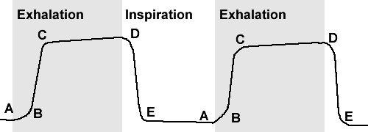
Normal capnograph trace
Phase I: Inspiratory baseline, which represents fresh gas flow, anesthetic plus oxygen, past the CO2 sensor during inspiration.
A-B: exhalation of CO2 free gas contained in dead space at the beginning of exhalation (emptying upper airway dead space). Phase I
The baseline should have a value of zero otherwise the patient is re-breathing CO2.

Slide 55
Cont’d …
Phase II: expiratory upstroke, which represents the arrival of CO₂ at the sensor just as exhalation begins. Usually very steep.
B-C: respiratory upstroke, representing the emptying of connecting airways & the beginning of emptying of alveoli. Phase II

Slide 56
Cont’d …
Phase III: expiratory plateau, which represents exhaled CO2. The peak of this exhaled CO2 is called the end-tidal CO2.
C-D: Expiratory (or alveolar) plateau, representing of emptying of alveoli - due to uneven emptying of alveoli, the slope continues to rise gradually during the expiratory pause. Phase III

Slide 57
Cont’d …
Phase IV: inspiratory downstroke, which is the beginning of the inhalation and the CO2 graphic curve falls steeply to zero.
D: End-tidal CO2 level - the best approximation of alveolar CO2 level
D-E: Inspiratory downstroke, as the patient begins to inhale fresh gas. Phase IV
E-A: Inspiratory pause, where CO2 remains at 0.

Slide 59
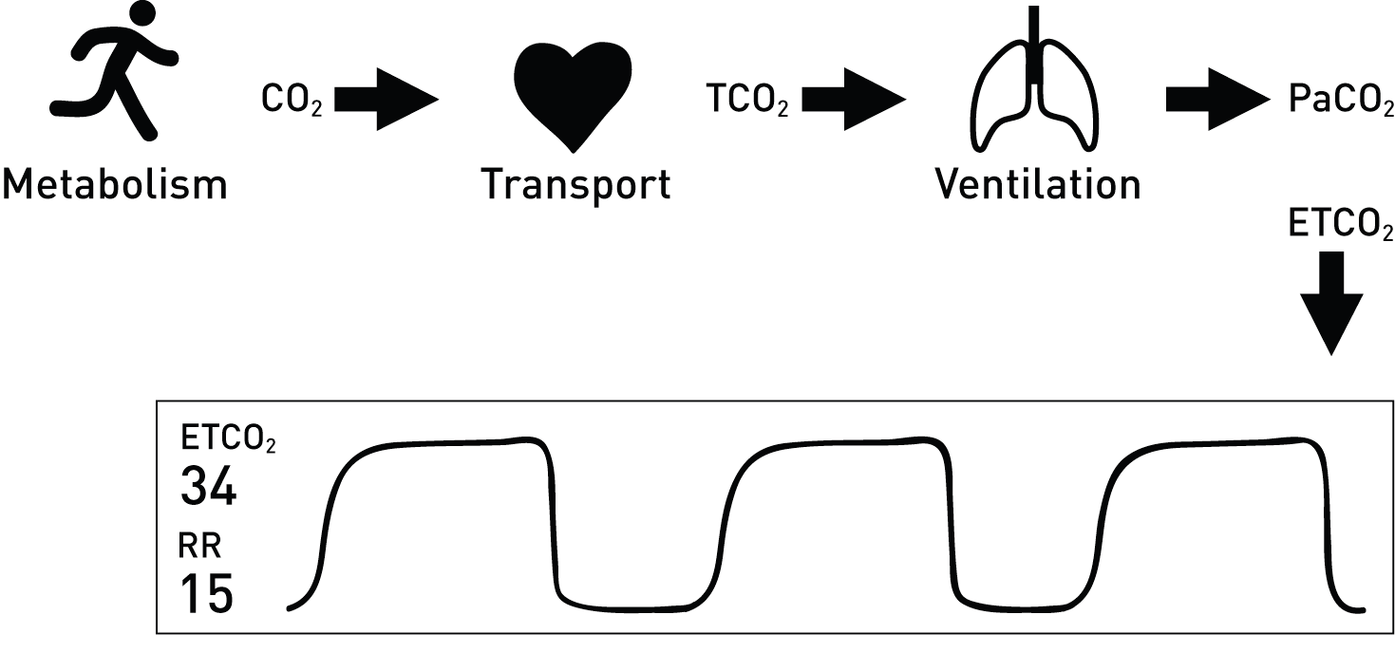
Physiology
In order for CO2 to be effectively eliminated from the body, there must be:-
Adequate blood flow to the lungs,
Adequate gas exchange across the alveolar-capillary membrane, and
Adequate ventilation of the lungs to “blow off” the CO2.
Therefore, changes in respired CO2 may reflect alterations in metabolism, circulation, respiration, the airway or breathing system.

Slide 60
1. Metabolism
Changes in ETCO2 can be a reliable indicator in metabolic changes.
Metabolic conditions that may increase ETCO2: fever, sepsis, shivering and convulsions
Metabolic conditions that may decrease ETCO2: hypothermia, paralytics and sedation
Malignant hyperthermia is a hypermetabolic state with a massive increase in CO2 production.
The increase occurs early, before the rise in temperature.
Early detection of this syndrome is one of the most important reasons for routinely monitoring CO2

Slide 61
2. Circulation
A decrease in ETCO2 is seen with a decrease in cardiac output if ventilation remains constant.
ETCO2 transport to the lungs is dependent on adequate cardiovascular function; any factor that alters cardiovascular function can affect CO2 transport to the lungs.
ETCO2 can alert the clinicians to changes in cardiovascular function of the patient with a “normal” respiratory status.
Cardiac conditions that may decrease ETCO2: hypovolemia, hypotension

Slide 62
3. Respiratory
ETCO2 can be a guide for determining the ventilation requirement of a patient.
Changes in respiratory function will affect the removal of CO2 from the lung thus affecting the ETCO2.
Respiratory conditions decreasing ETCO2 includes hyperventilation & large TV ventilation.

Slide 63
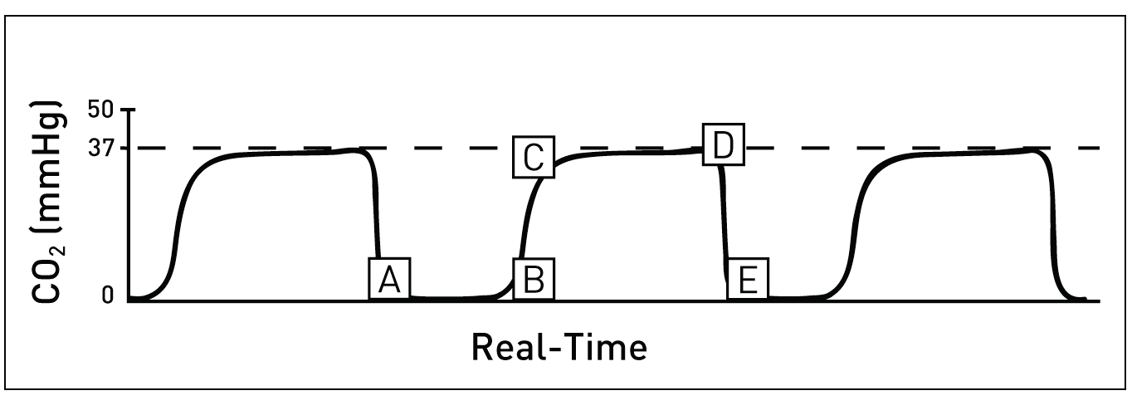
Normal Capnograph
Features:
Baseline (should be zero)
Expiratory Upstroke (sharp rise)
Expiratory Plateau (should be straight)
End-Tidal Concentration (average 37)
Inspiratory down stroke (sharp down stroke)

Slide 64
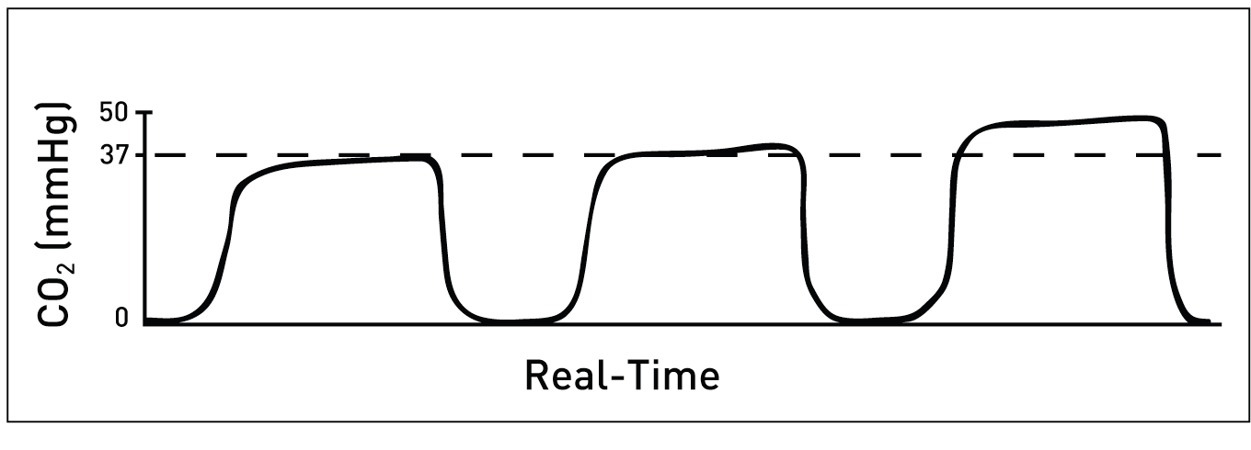
Increasing ETCO2 level
An increase in the level of ETCO2 from previous levels
Possible Causes:
Decrease in respiratory rate (hypoventilation)
Decrease in tidal volume (hypoventilation)
Increase in metabolic rate
Rapid rise in body temperature
Malignant hyperthermia

Slide 65
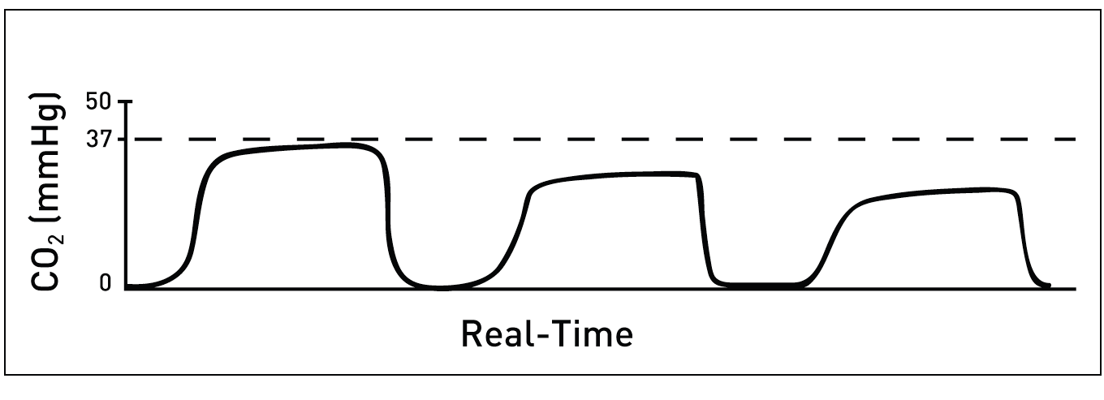
Decreasing ETCO2 level
A decrease in the level of ETCO2 from previous levels
Possible Causes:
Increase in respiratory rate (hyperventilation)
Increase in tidal volume (hyperventilation)
Decrease in metabolic rate
Decrease in core body temperature
Hypovolemia/ Hypotension

Slide 66
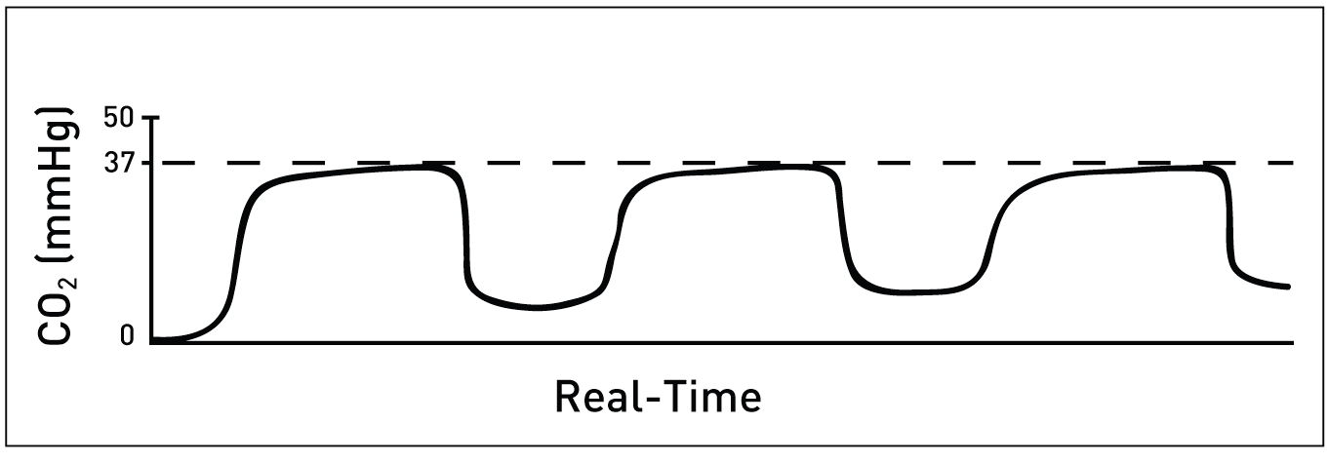
Rebreathing
Elevation of the baseline indicates rebreathing (may show increase in ETCO2), Possible Causes
Faulty expiratory valve on ventilator or anesthesia machine
Insufficient fresh gas flow in Mapelson circuit
Malfunction of system (Excessive dead space in circuit)
Exhausted/ expired soda lime (circle system)
Insufficient expiratory time

Slide 67
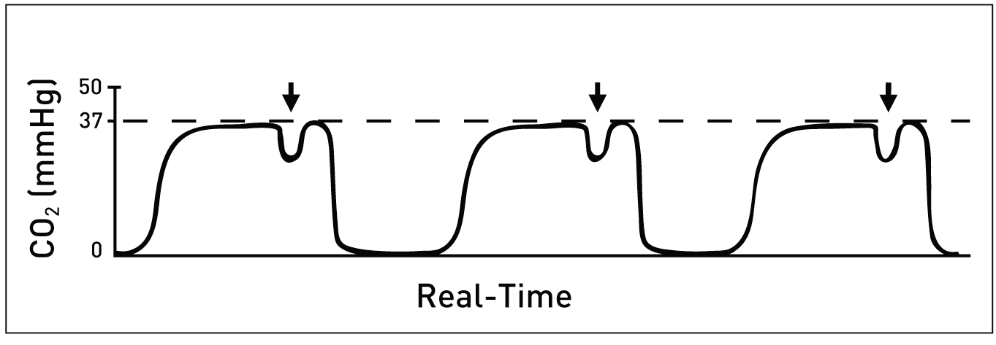
Muscle Relaxants (Patient breathing whilst ventilated)
Curare Clefts are seen in the plateau portion of the capnogram. They appear when the action of the muscle relaxants begin to subside and spontaneous ventilation returns.
Characteristics:
Depth of the cleft is inversely proportional to the degree of drug activity
Position is fairly constant on the same patient but not necessarily present with every breath

Slide 68
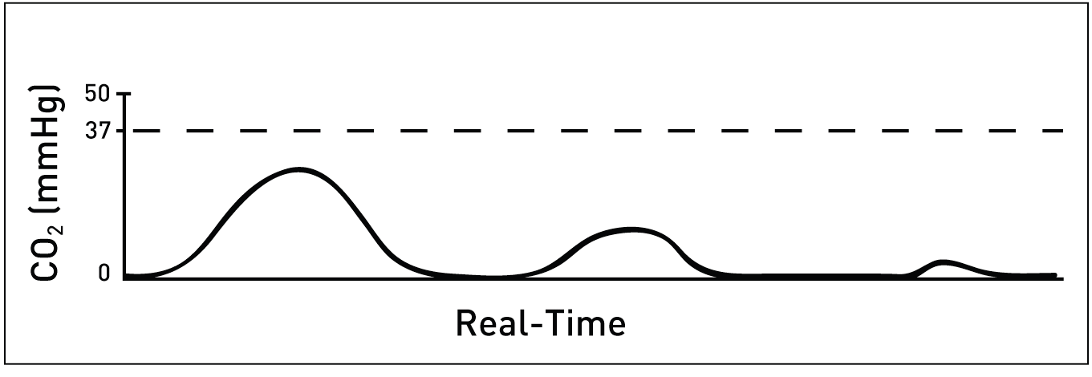
Endotracheal Tube in the Esophagus
A normal capnogram is the best available evidence that the ET tube is correctly positioned and that proper ventilation is occurring.
When the ET tube is placed in the esophagus, either no CO2 is sensed or only small transient waveforms are present.

Slide 69
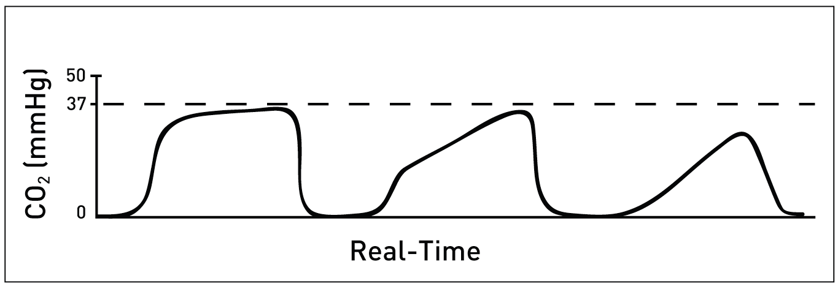
Obstruction in Breathing Circuit or Airway
Obstructed expiratory gas flow is noted as a change in the slope of the ascending limb of the capnogram (expiratory plateau may be absent)
Obstruction in the expiratory limb (ETT) of the breathing circuit
Presence of a foreign body in the upper airway
Partially kinked or occluded artificial airway
Bronchospasm (anaphylaxis, asthma,)
Chronic obstructive pulmonary disease (COPD)

Slide 70
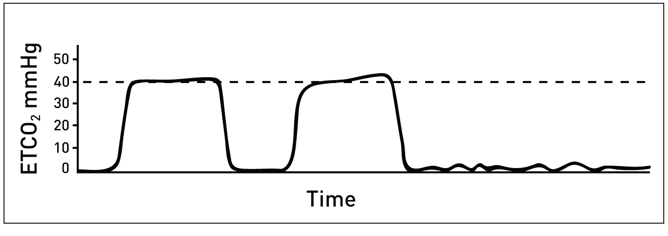
Apnea
Complete loss of waveform indicating no CO2 present, since this occurred suddenly
Consider:
Dislodge ET tube or disconnection
Total obstruction of ET tube
Equipment malfunction, check all connections

Slide 71
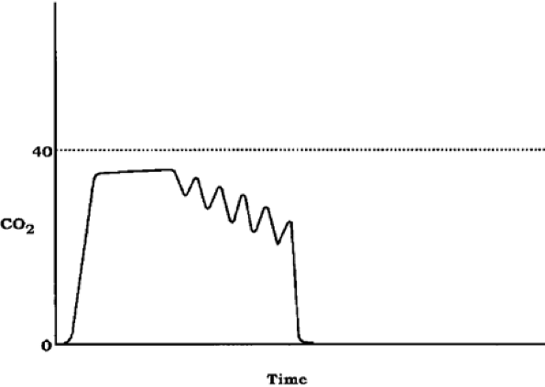
Cardiac oscillations in self-ventilating patient
Cardiogenic oscillations appear as small, regular, tooth-like humps at the end of the expiratory phase.
They may be single or multiple, and the heights may vary considerably.
They are believed to be due to the heart beating against the lungs

Slide 72
Sudden loss of cardiac output (eg pulmonary embolism)
pCO₂
35
time
Sudden drop in ET_{CO2}

Slide 73
Capnography (cont)
Summary of interpretation
Increased ET_{CO2}
Rebreathing
Hypoventilation
Increased production
-Sepsis
-Malignant hyperthermia
-Hypermetabolism
Decreased ET_{CO2}
Hyperventilation
Reduced CO
Hypothermia
Hypometabolism

Slide 74
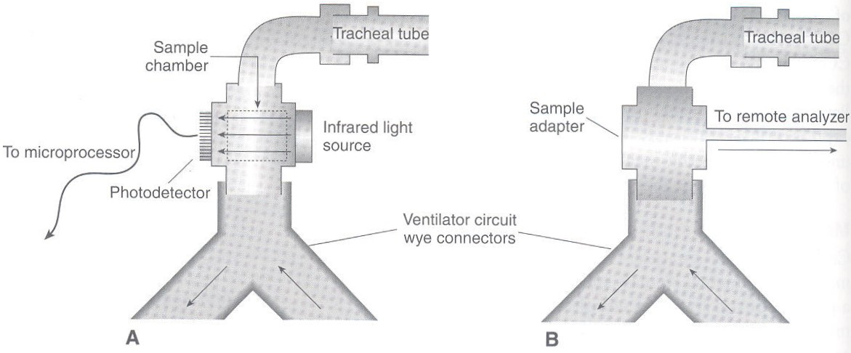
Capnography (cont.)
Components
(1) Side stream – 1.2mm internal diameter tube made of Teflon (samples 150-200 mL / min; often lost from circuit)
Connected to patient end (small increase in dead space) then delivers gases to sample chamber
Disadv-Moisture trap with exhaust port
Photodetector

Slide 75
Capnography (cont.)
alternative design
(2) Mainstream – Infrared Ray source and detector placed on either side of circuit, near patient (with clear plastic tubing)
No extraction of gases from circuit
Electrical signal from near-patient transducer passed to display unit

Slide 76
Capnography (cont.)
Sidestream vs mainstream capnography
Side stream
Mainstream
Multiple gases can be analysed (O₂, volatile, N₂0)
CO₂ measurement only
Delay in display output
Virtually instantaneous
Can give subtle (hard to detect) leak
Any leaks obvious
Sensor damage less common
Sensor close to patient and vulnerable to damage
Can be used with nasal prongs / face mask
Only used with breathing circuit

Slide 77
Capnography (cont.)
General limitations
ET_{CO2} may not reflect Pa_{CO2}
- COPD (trace still rising at onset of inspiration)
- sudden changes in cardiac output
- significant parenchymal lung disease (diffusion barrier)
Difficulties in paediatric patients (small volumes, high rate)
N₂O use may cause interference
- similar absorption spectra

Slide 78
Pulse Oximetry or Capnography?
Capnographs monitor ventilation whereas pulseoximeters monitor oxygen saturation.
With Capnography, apnea periods in the patient are reflected immediately on occurrence with breath-to-breath feedback; by contrast, pulse oximetry has a lag time during breath-to-breath changes.
Because a patient often is given supplemental oxygen, this actually may mask an apnic event keeping the oxygen saturation artificially high during apnic episodes.
Best practice: to use pulse oximetry in conjunction with Capnography to understand the patient’s overall status.

Slide 79
Anesthetic Monitoring
Clinical monitoring
Pulseoxymetry
Capnography
Non invasive Blood pressure
ECG
Peripheral nerve stimulators
Volatile / gas analyser & anaesthesia depth
Temperature monitoring
Documentation
√
√
√

Slide 80
C u soon !!!

